Slide 1

Company Rating Website
Capstone Project
Presentation
卒業論文
プレゼンテーション
Summer 2016

Slide 2
私達について
About Us
ChienBD
HungNV
QuangNN
LamNS
DangT
HungTQ

Slide 3
アウトライン
Outlines
1
Introduction - 導入
2
Project Management - プロジェクト管理
3
Software Requirement Specification - ソフトウェア要求仕様
4
5
6
7
8
Software Design Description - ソフトウェア設計説明書
Quality Control - 品質管理
Project Result - プロジェクト結果
Demo - デモ
Q & A - 質問と回答

Slide 4
アウトライン
Outlines
1
Introduction - 導入
2
Project Management - プロジェクト管理
3
Software Requirement Specification - ソフトウェア要求仕様
4
5
6
7
8
Software Design Description - ソフトウェア設計説明書
Quality Control - 品質管理
Project Result - プロジェクト結果
Demo - デモ
Q & A - 質問と回答

Slide 5
1 – Introduction - 導入
1.1 Current Situation - 現在状況
Nowadays, finding a company for works is easy.
But
People doesn’t know whether the company would fit or not.
Lack of information from other workers, formerly or currently.
So
Need an environment for trading information.

Slide 6
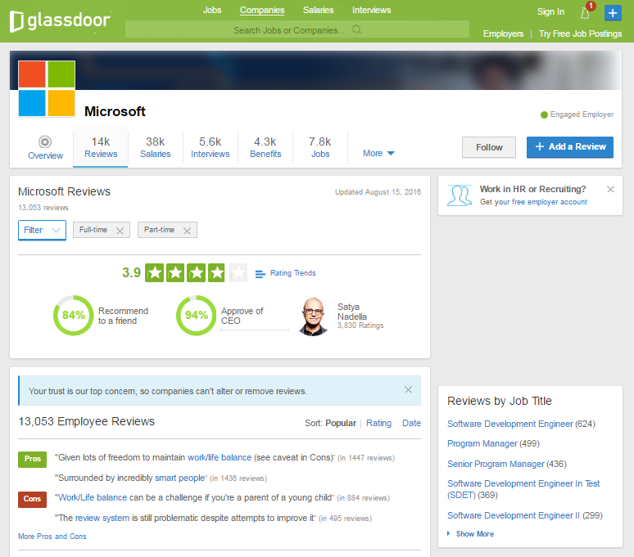
1 – Introduction - 導入
1.1 Current Situation - 現在状況
Glassdoor.com
Advantages:
Famous.
Controllable level of details on review.
Connection to employers.
Disadvantages:
Does not support Vietnamese.
UI is unintuitive.
Unclear how gathered information are used.

Slide 7
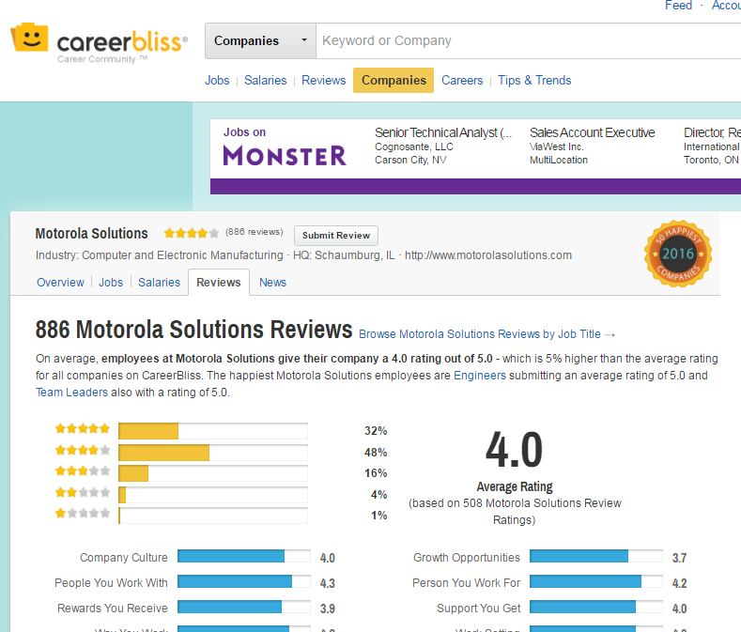
1 – Introduction - 導入
1.1 Current Situation - 現在状況
CareerBliss.com
Advantages:
Intuitive design.
Information is scientifically generalized.
Does not require an account.
Disadvantages:
Only accept US based company.
Lacking in information.
Does not support Vietnamese.

Slide 8
1 – Introduction - 導入
1.2 Idea - アイデア
Create a website that
Helps user to have an insider’s view from employees/ex-employees’ review on any available company.
Share anything they like, be it about the profession’s upbringing, the opinions of those who worked there, or just simply how well the employee would be treated.
Discuss with other people.
Support Vietnamese users.

Slide 9
アウトライン
Outlines
1
Introduction - 導入
2
Project Management - プロジェクト管理
3
Software Requirement Specification - ソフトウェア要求仕様
4
5
6
7
8
Software Design Description - ソフトウェア設計説明書
Quality Control - 品質管理
Project Result - プロジェクト結果
Demo - デモ
Q & A - 質問と回答

Slide 10
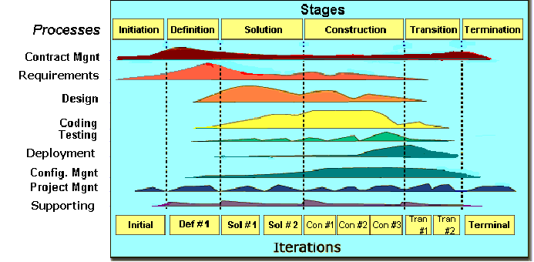
2 - Project Management - プロジェクト管理
2.1 Software Process Model - ソフトウェアプロセスモデル
FPT Software process model

Slide 11
2 - Project Management - プロジェクト管理
2.1 Software Process Model - ソフトウェアプロセスモデル
Initiation
Identify business functions of the system.
Solution
Complete SRS, Architecture Design and Database Design.
Construction
Termination
Complete software packages and Report #5, #6.
Determine scope, condition, limitation, project risk.
List main functions.
Complete Report #1.
Complete Report #2.
Complete Report #3 and #4.
Preparing presentation.
Complete Project.
Complete coding and testing.
Notes:
RUP

Slide 12
2 - Project Management - プロジェクト管理
2.2 Project Schedule - プロジェクト計画
09/5
16/8
27/6
Initiation
20/5
Solution
Construction
Termination
1/9

Slide 13
2 - Project Management - プロジェクト管理
2.3 Project Organization - プロジェクト組織
Bùi Đình Chiến
Instructor
Nguyễn Sơn Lâm
Test Leader/QA
Trần Quốc Hưng
Designer
Trần Đăng
Technical Leader
Nguyễn Nhật Quang
Developer
Trần Quốc Hưng
Developer
Nguyễn Việt Hùng
Developer
Nguyễn Nhật Quang
Tester
Trần Quốc Hưng
Project manager
Nguyễn Sơn Lâm
Designer

Slide 14







2 - Project Management - プロジェクト管理
2.4 Tools & Infrastructure - ツールと インフラストラクチャ
Project Management
Documentation
Github Desktop
MS PowerPoint 2013
MS Excel 2013
MS Word 2013
MS Project 2013
Astah
Illustrator CS

Slide 15








2 - Project Management - プロジェクト管理
2.4 Tools & Infrastructure - ツールと インフラストラクチャ
Development
Sublime Text
Chrome
Firefox
Vim
Putty
Redmine
Acunetix
Robomongo

Slide 16
2 - Project Management - プロジェクト管理
2.5 Risks Management - リスク管理
# | Risk | Category | Root Cause | Triggers | Avoidance plan | Contingency plan | Fallback plan | Risk Owner | Probability | Impact | Status
1 | Conflict among team members | People | Team member doesn't understand each other | Internal issue | Team building to improve teammates’ relations | Have a meeting to resolve the conflicting problem |  | LamNS | Low | High | Resolved
2 | Team member don’t meet deadlines | Process | Undisciplined and habits of team member, loose management | Have a deadline | Setting rule and punishment for not meeting the deadline: named at meeting minute | Punish the member who didn't meet the deadline. Working over time. | Ask for help from outsider, supervisors | HungTQ | Medium | Medium | Resolved
3 | The server has defective parts. | Technology | Defective power supply | Server is down | Ensure the supplier provides with the adequate warranties | Replace or fix the defective parts quickly | Buy a new one | LamNS | Low | Medium | Closed

Slide 17
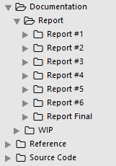
2 - Project Management - プロジェクト管理
2.6 Configuration Management - コンフィグレーション管理
Source Code
Reference: Additional material from various sources for reference and template
Documentation:
Report: contains 7 folders - Report #1 to 6 and a Report Final folder
WIP: Documents in progress
Folder Structure

Slide 18
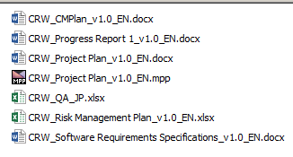
2 - Project Management - プロジェクト管理
2.6 Configuration Management - コンフィグレーション管理
Rule:
ProjectCode_Document’s name_v<x.x>_language
ProjectCode: CRW
Document’s name: Project Plan, Progress Report…
v<x.x>: Document’s version. Ex: v1.0, v1.1,…
Language:
EN: English
JP: Japanese
Naming conventions

Slide 19





2 - Project Management - プロジェクト管理
2.7 Communication Management - コミュニケーション管理

Slide 20
アウトライン
Outlines
1
Introduction - 導入
2
Project Management - プロジェクト管理
3
Software Requirement Specification - ソフトウェア要求仕様
4
5
6
7
8
Software Design Description - ソフトウェア設計説明書
Quality Control - 品質管理
Project Result - プロジェクト結果
Demo - デモ
Q & A - 質問と回答

Slide 21



3 – Software Requirement Specification
ソフトウェア要求仕様
3.1 Business Actors -ビジネスアクター
Administrator
User
Moderator

Slide 22
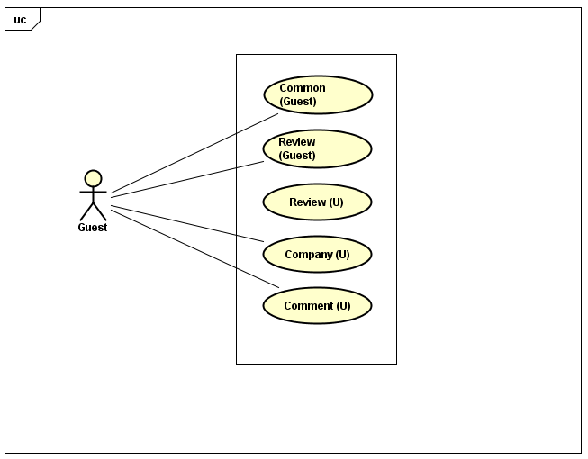
3 – Software Requirement Specification
ソフトウェア要求仕様
3.2 Functional Requirements - 機能要求

Slide 23
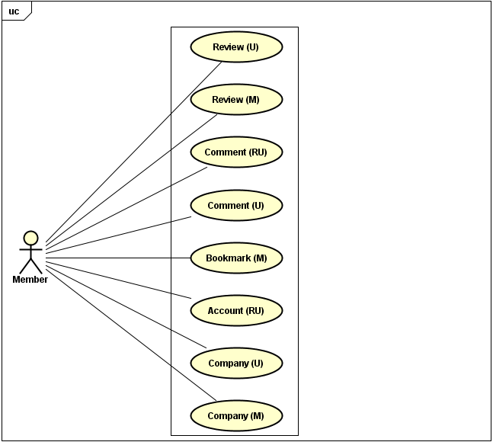
3.2 Functional Requirements - 機能要求
23

Slide 24
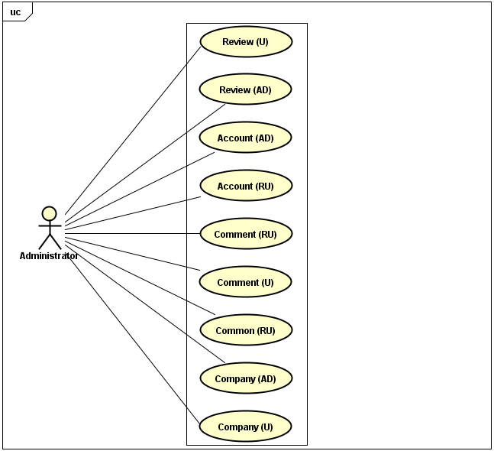

Slide 25
3 – Software Requirement Specification
ソフトウェア要求仕様
3.3 Non-functional Requirements - 非機能要求
Database must be backed up on a daily basis and can be recovered whenever necessary.
In term of response time, it should be humanly acceptable, with actual numbers being tied to user’s internet connection speed.
No high severity security risks (checked by Acunetix)

Slide 26


3 – Software Requirement Specification
ソフトウェア要求仕様
3.3 Non-functional Requirements - 非機能要求
Server:
Amazon EC2 server with t2.micro instance or equivalence
Client
Processor: 1 GHz
Ram: 2 GB
Hard disk: 20 GB
Graphic card:
DirectX 9 or later AND
Support WDDM 1.0 driver

Slide 27
アウトライン
Outlines
1
Introduction - 導入
2
Project Management - プロジェクト管理
3
Software Requirement Specification - ソフトウェア要求仕様
4
5
6
7
8
Software Design Description - ソフトウェア設計説明書
Quality Control - 品質管理
Project Result - プロジェクト結果
Demo - デモ
Q & A - 質問と回答

Slide 28
4 – Software Design Description
ソフトウェア設計説明書
4.1 Architectural Representation –アーキテクチャ表現
Technology
MongoDB
ExpressJS
AngularJS
NodeJS

Slide 29
4 – Software Design Description
ソフトウェア設計説明書
4.2 Database Design -データベース設計
Notes:
Table diagram/ object diagram, check MongoDB offical document, zoom click

Slide 30
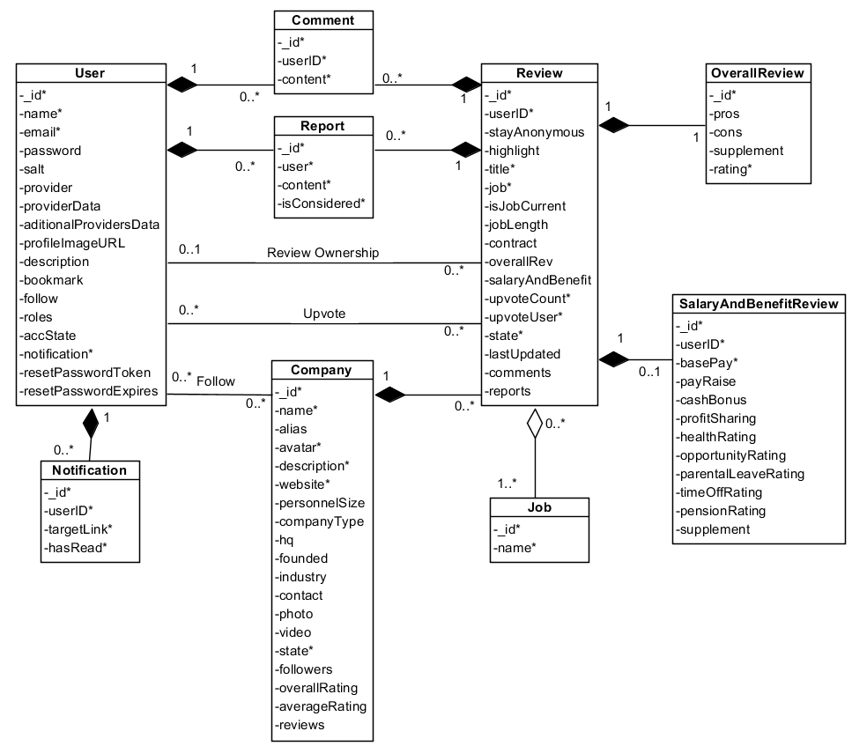

Slide 31
4 – Software Design Description
ソフトウェア設計説明書
4.3 Screen Flow - 画面の流れ

Slide 32
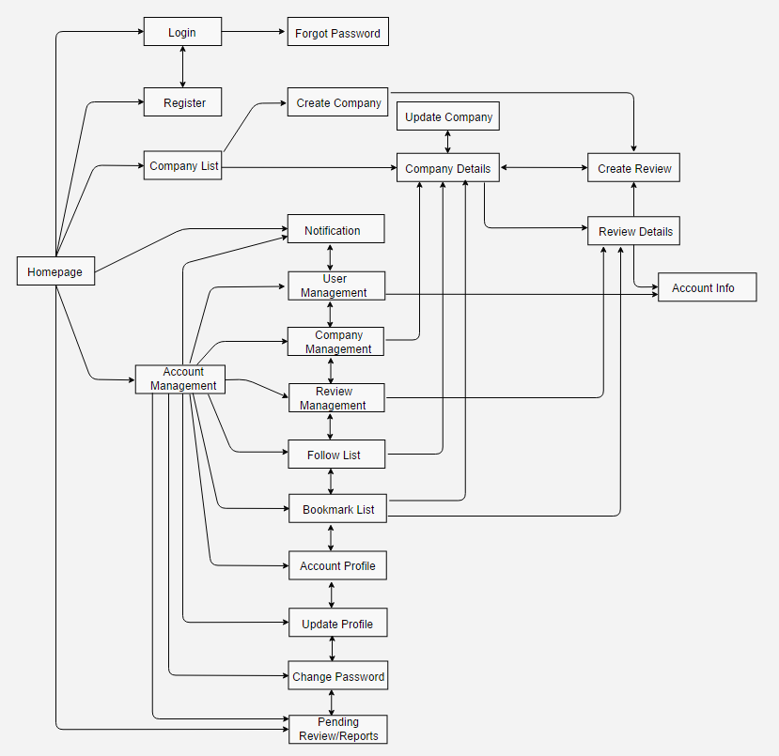

Slide 33
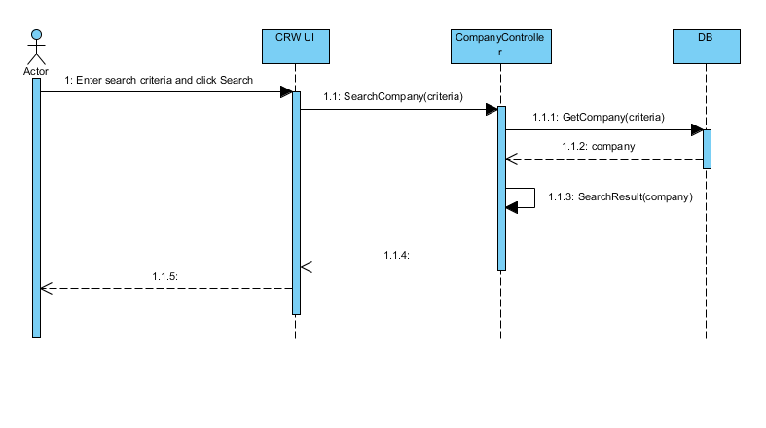
4 – Software Design Description
ソフトウェア設計説明書
4.4 Sequence Diagram -シーケンス図

Slide 34
アウトライン
Outlines
1
Introduction - 導入
2
Project Management - プロジェクト管理
3
Software Requirement Specification - ソフトウェア要求仕様
4
5
6
7
8
Software Design Description - ソフトウェア設計説明書
Quality Control - 品質管理
Project Result - プロジェクト結果
Demo - デモ
Q & A - 質問と回答

Slide 35
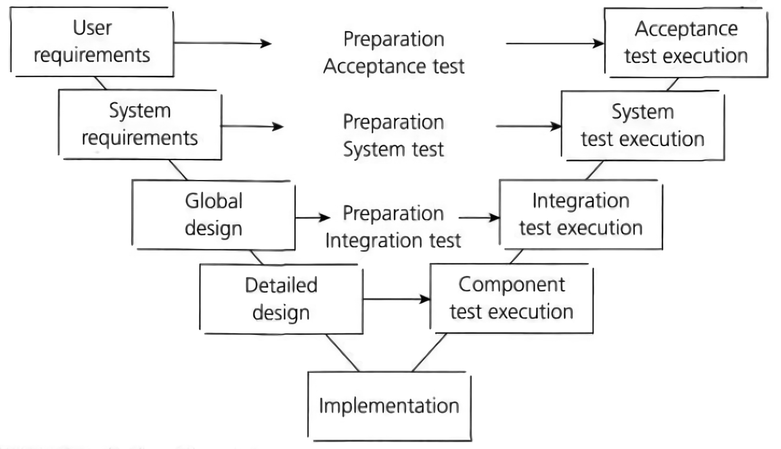
5 – Quality Control - 品質管理
V-model process

Slide 36
5 – Quality Control - 品質管理
5.1 Review - レビュー
Project Plan
SRS
Design
Coding
Test Document

Slide 37



5 – Quality Control - 品質管理
5.1 Review - レビュー
Self review
Peer review
Supervisor review

Slide 38
5 – Quality Control - 品質管理
5.2 Test - テスト
Test Process
Test Report

Slide 39

5 – Quality Control - 品質管理
5.2.1 Test Process -テストのプロセス
Test Plan
Test Case
Test Report
Execute Test
Log Bug
Re-test
Based on Project Plan, Project Schedule, SRS to create test plan:
Features need testing
Acceptance criteria
Environment
Responsibilities
Schedules

Slide 40
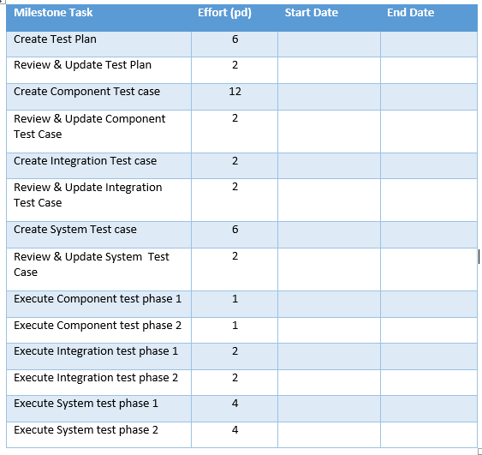
5 – Quality Control - 品質管理
5.2.1 Test Process -テストのプロセス
Test Plan
Test Case
Test Report
Execute Test
Log Bug
Re-test
Test Approach:
Unit Test: Developer
Integration Test: Tester
System Test: Tester
Acceptance Test: Supervisor
Test Environment:
Chrome 50 or above
Firefox 40 or above
Security Scanner:
Acunetix

Slide 41
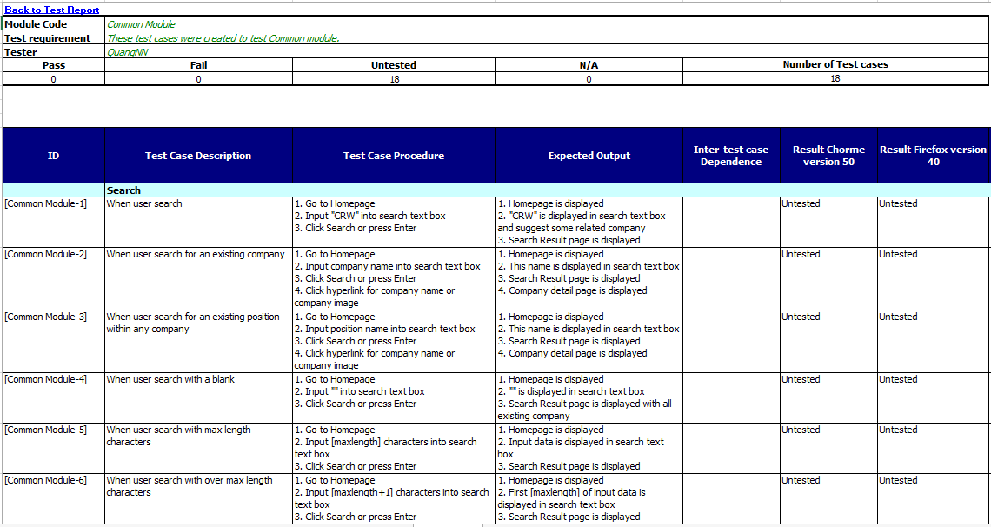
5 – Quality Control - 品質管理
5.2.1 Test Process -テストのプロセス
Test Plan
Test Case
Test Report
Execute Test
Log Bug
Re-test

Slide 42
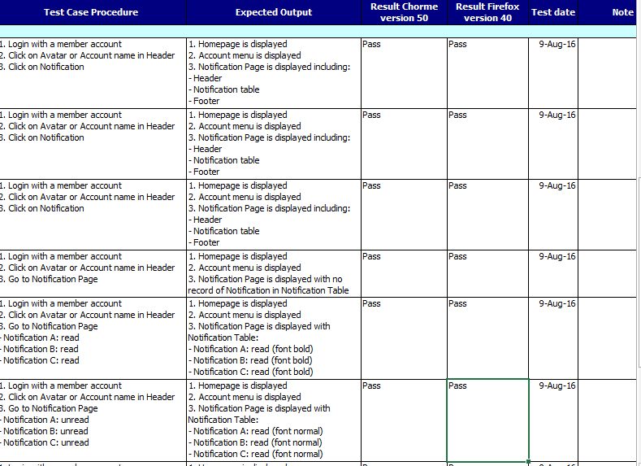
5 – Quality Control - 品質管理
5.2.1 Test Process -テストのプロセス
Test Plan
Test Case
Test Report
Execute Test
Log Bug
Re-test

Slide 43
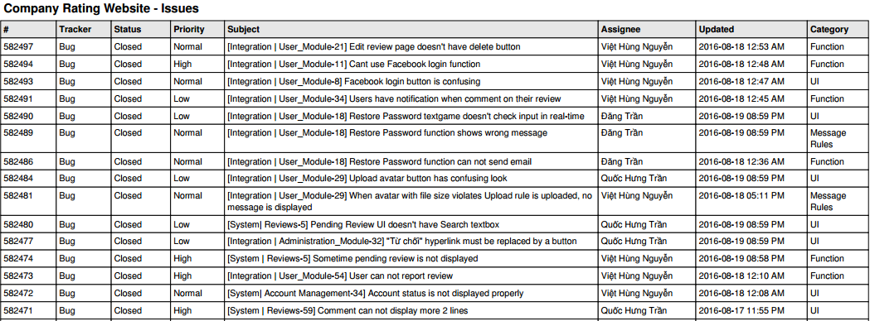
5 – Quality Control - 品質管理
5.2.1 Test Process -テストのプロセス
Test Plan
Test Case
Test Report
Execute Test
Log Bug
Re-test
Exported from hostedredmine.com

Slide 44
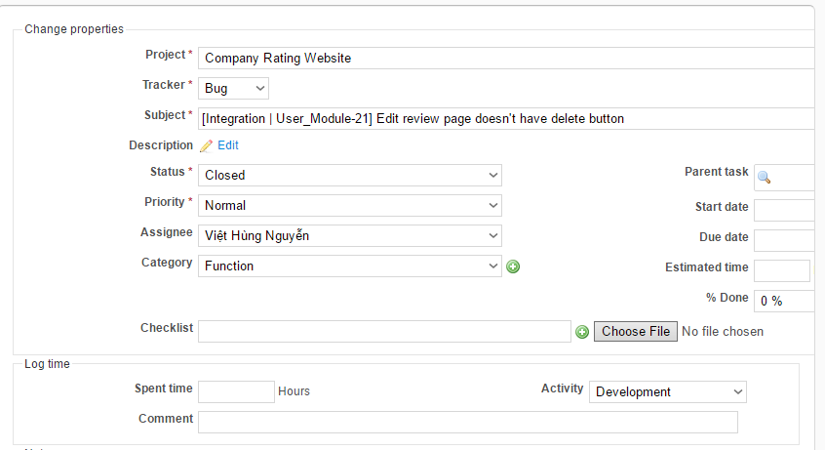
5 – Quality Control - 品質管理
5.2.1 Test Process -テストのプロセス
Test Plan
Test Case
Test Report
Execute Test
Log Bug
Re-test
Developer fixes bug
Developer commits code and changes status to ‘Resolved’
Tester re-tests
Tester change status to ‘Approved’ if success
Leader checks and change status to ‘Closed’

Slide 45
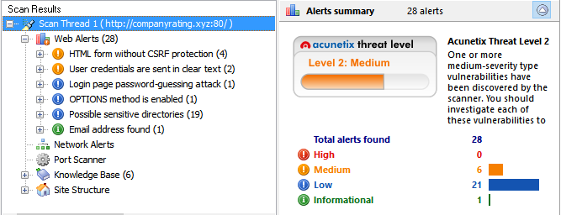
5 – Quality Control - 品質管理
5.2.1 Test Process -テストのプロセス
Test Plan
Test Case
Test Report
Execute Test
Log Bug
Re-test
Tester write test report for each test phase
Test leader create Test report after finish testing phase

Slide 46
5 – Quality Control - 品質管理
5.2.2 Test Report -テストのレポート
Phase | Round 1 |  | Round 2 |  | Round 3
 | Pass | Fail | Pass | Fail | Pass | Fail | Accepted
Unit Test | 322 | 0 | 337 | 0 | 337 | 0 | 0
Intergration Test | 142 | 42 | 180 | 20 | 192 | 0 | 0
System Test | 300 | 90 | 450 | 54 | 484 | 0 | 30
Total | 764 | 132 | 967 | 74 | 1013 | 0 | 30

Slide 47
5 – Quality Control - 品質管理
5.2.2 Test Report -テストのレポート
Defects | Logged | %Accepted | %Closed | %Invalid | %Open
Critial | 0 | 0% | 0% | 0% | 0%
High | 12 | 0% | 100% | 0% | 0%
Medium | 30 | 0% | 100% | 0% | 0%
Low | 38 | 8% | 100% | 0% | 0%
Total | 80 | 4% | 100% | 0% | 0%

Slide 48
アウトライン
Outlines
1
Introduction - 導入
2
Project Management - プロジェクト管理
3
Software Requirement Specification - ソフトウェア要求仕様
4
5
6
7
8
Software Design Description - ソフトウェア設計説明書
Quality Control - 品質管理
Project Result - プロジェクト結果
Demo - デモ
Q & A - 質問と回答

Slide 49
6 – Project Result - プロジェクト結果
6.1 Project summary - プロジェクト要約
Main Objective | Create a website that helps user to have an insider’s view from employees/ex-employees’ review on any available company.
Source repository | https://github.com/ShiroNek0/CRW
 | Plan | Actual
Start date | 09/05/2016 | 09/05/2016
End date | 01/09/2016 | 01/09/2016
Efforts (person days) | 400 | 400
Test cases/KLOC | ~80 | 80
Defects | 100 | 80
LOC (Total) | ~10000 | 13218
Requirement coverage (%) | 100 | 100
Test coverage (%) | 100 | 100

Slide 50


6 – Project Result - プロジェクト結果
6.2 Limitation & Expectation - 制限と期待
Limitation:
Unresponsive design
No English interface.
Little interaction between users.
Expectation in future:
Support multi-language.
Responsive design for mobile.
More interaction between users (PM, Chatbox, Award, Achievement…).

Slide 51

6 – Project Result - プロジェクト結果
6.3 Lessons Learnt -学んだ教訓
Experience gained in:
Working as a team and working individually
Managing a team and planning a full project
Respecting other member’s opinions
Resolving conflicts between members

Slide 52
アウトライン
Outlines
1
Introduction - 導入
2
Project Management - プロジェクト管理
3
Software Requirement Specification - ソフトウェア要求仕様
4
5
6
7
8
Software Design Description - ソフトウェア設計説明書
Quality Control - 品質管理
Project Result - プロジェクト結果
Demo - デモ
Q & A - 質問と回答

Slide 53

Q & A
質問と回答

